Slide 1
Bringing ML to Mobile Apps – Let’s build an app to perform Face Recognition using Flutter
Don Ward
Quicken Loans
Senior Research Engineer
donward@quickenloans.com
@donwardpeng

Slide 2
Who should be here?
Notes:
First thing first – to be respectful of all attendees and to ensure you are able to get the most out of this session – this session is for those who,
Know a programming language.
People who enjoy curly braces.
Introductory course - no authors.
No need to have done mobile development.
Admin access on PC.
Ideally, have heard of Flutter, and want to learn it.

Slide 3
The Agenda
Flutter
Dart
What are we building today?
What does it use?
Let’s setup our environments!

Slide 4
Do you want to quickly build great looking, performant apps for multiple screens from one codebase?
Notes:
So let’s talk about Flutter.
Here is the question that you should ask yourself when determining if Flutter is the right fit for your project.
Let’s break this statement down -

Slide 5
Bold statements in yellow:
Quickly build
Great looking apps
Performant apps
Support for multiple screens
All from one codebase
Notes:
So let’s break that down, here are the bold statements about Flutter (in yellow – because yellow is important).
Let’s break this down, and discuss each one starting with,

Slide 6
No. 4 – Support for multiple screens
Notes:
No 4 – support for multiple screens.

Slide 7

Stable
‘Stable-ish’
Working On
Notes:
Let’s take a look at the current platforms that Flutter supports.
iOS and Android – Stable
Web – Beta – just moved into Beta on Dec 11, 2019 - this means the next step is stable
macOS – Alpha - just announced on Dec 11, 2019 – Beta next
Windows and Linux – Technical Preview
So as you can tell, Flutter is capable of creating apps that run on multiple platforms whether it be mobile, web or desktop operating systems. With this multiple platform support comes multiple screens. Let’s get back to breaking down our bold statement about Flutter.

Slide 8

Bold statements in yellow:
Quickly build
Great looking apps
Performant apps
Support for multiple screens
All from one codebase
Notes:
Ok – back to our list of bold yellow statements, what’s next, let’s talk about...

Slide 9
No. 2 – Great looking apps
Notes:
No 4 – support for multiple screens.

Slide 10
So, who is using it?
Notes:
So to me great looking apps – need to have folks already using it to back up the claim.
One thing I will share is that Flutter follows the modern paradigm of creating mobile apps that really allow a brand to make their branding prevalent through out the app, without relying too much on the platform widgets put forth by Apple and Google.

Slide 11
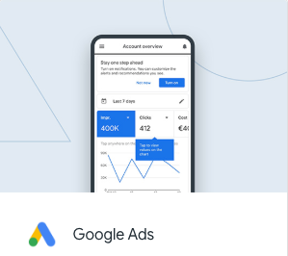

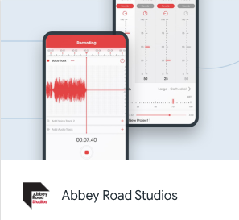
Early Adopters
Notes:
Flutter hit version 1.0 in Dec 2018.
Before the version 1.0 release, they apps were already using Flutter in their apps.
The Google Ads app – this is the app that Google provides for sellers and buyers of ads to manage their ads on Google. Pretty important app! What you will find is that Google eats it own dogfood with respect to Flutter and many of their consumer facing apps are starting to use it.
Abbey Road Studios – their first mobile app called Topline was written in Flutter.
Alibaba Group – they initially used Flutter for some of the screens in their app and continue to use it.

Slide 12
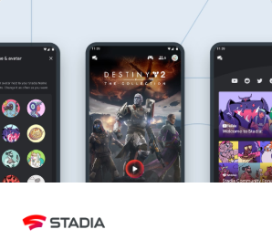
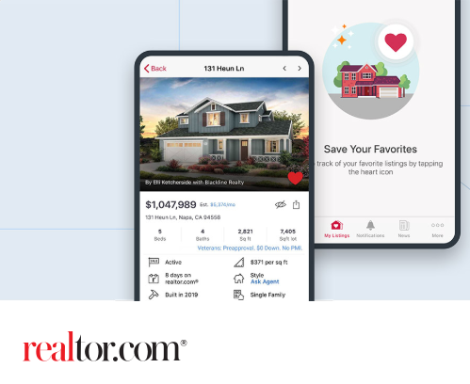
More recent adopters
Notes:
So who is using it now?
The Realtor.com app is written entirely in Flutter
Very recently – the Google Stadia team chose Flutter for their mobile app on iOS and Android. Now I know Google Stadia has had some mixed reviews but it speaks volumes to Flutter’s adoption when a non-Flutter team with Google uses it for their mobile app. The Google Stadia engineering lead stated that some of the reasons they chose to use Flutter was,
The speed and ability to rapidly prototype using Flutter.
The ability to support Android and iOS from one codebase.

Slide 13
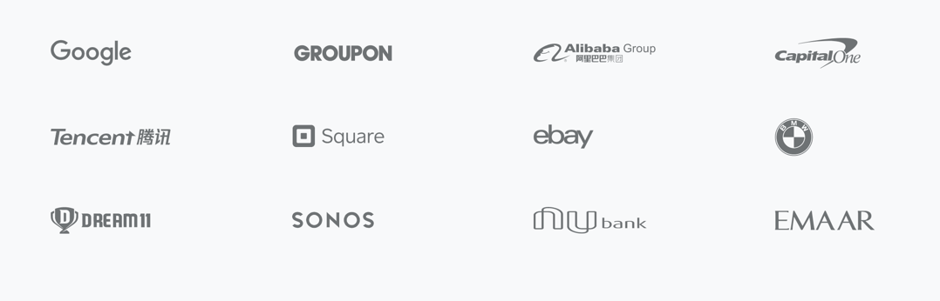
And some more...
Notes:
And here are some more companies that are using Flutter for app development today.

Slide 14
What about Apple and their store review/approval process?
Notes:
As a side note, as I have discuss Flutter with many developers, a frequent question that arises is...

Slide 15
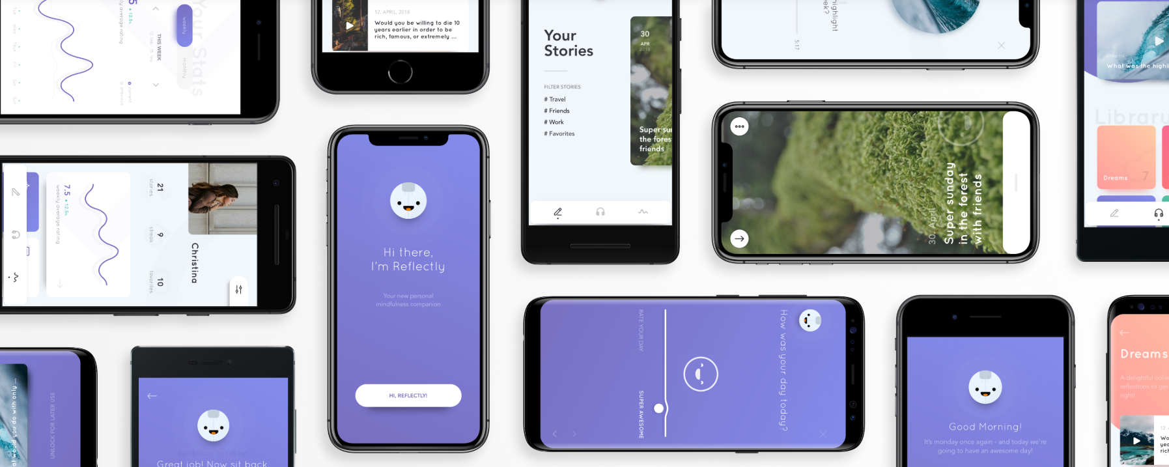
Notes:
To which I answer and point to one last app– Reflectly.
How many of you have ever heard of Reflectly? They build a journal and diary app for Android and iOS – the UI is really good and transitions are very fluid. I have been using the app for a few weeks and it is impressive how it works.
They have been around for a few years (since 2017), and are quite popular in the space.
Earlier this year they re-wrote their app from React Native and in Aug 2019 they were featured in the Apple app store as the app of the day.
This is a prime example of an app written in Flutter that was not only approved by Apple for release, it was featured in the store.

Slide 16
Bold statements in yellow:
Quickly build
Great looking apps
Performant apps
Support for multiple screens
All from one codebase
Notes:
Ok – back to our list of bold yellow statements, what’s next, let’s talk about...

Slide 17
No. 3 – Performant Apps
Notes:
So what makes Flutter performant? The answer lies in how Flutter approaches rendering to the screen and how it is unique in this respect? Let’s look under the covers at how mobile development with Flutter works to get an idea.

Slide 18
Native Mobile Apps
Notes:
Let’s talk about the current day. This is how native mobile apps work for the most part.
On the left side in green, your app uses Native Code to communicate with the underlying native OEM Widgets from Google and Apple. These are shown in blue on the right. These Widgets then draw themselves on the screen using a canvas and handle incoming events with handlers. The Canvas and Events are managed by the OEM Widgets which interact with your app.
What is a good example of a OEM Widget? How about a raised button on Android and iOS? These are both widgets provided by Google and Apple as part of the Android SDK and iOS SDK. The look and feel of them is managed by these SDKs.
If your app wants to communicate with platform services like location data, Bluetooth connectivity, and audio you use the same SDK to communicate with these platform services.
This is what current day mobile app development looks like.

Slide 19
PhoneGap, Cordova, Ionic and WebView based Systems
Notes:
Ok, let’s rewind to when the first iPhone and iPad were released.
So after Apple first released the iPhone and iPad, and before they had an SDK they suggested 3rd party apps written for WebvVews.
PhoneGap, Cordova, Ionic and other WebView based Systems for mobile development took this approach and continue to do so today.
So the premise is, you write your app in HTML and other web languages (shown on the left in Green), and your app is hosted in a Webview on the platform (shown on the right in blue). This widget controls the canvas and events.
In this scenario JavaScript runs in what we call it’s own realm and the Webview runs in it’s own realm on the platform.
If you want to work with platform services you use a bridge between JavaScript and these platforms services.
A few advantages of this,
You use Javascript and other standardized web languages to create your app – so lower barrier to entry.
You Javascript is portable.
A few disadvantages – Javascript runs in it’s own realm, and native runs in it’s own realm. Both run fast in their own realm, but the bridge does not necessarily run quickly.

Slide 20
React Native
Notes:
Let’s fast forward to 2015. Facebook took the covers off of React Native.
At this point, React Programming had become very popular and continues to be so today.
With React Native, Facebook added React Programming concepts to the JavaScript and Webview model used earlier.
With a React Native app, you create your app in HTML, CSS and JavaScript and there is a bridge between the JavaScript and Native realms. Your JavaScript app holds a DOM for the elements on the screen and the bridge communicates that DOM to the native platform.
React Native is hugely popular since it allow for web style programming using reactive elements on mobile.
As you can see the bridge is used not just between the platform services, it is also used to communicate to the native widgets on the platforms.
As we discussed earlier JavaScript in this case runs in it’s own realm (in green) and the platform Widgets and services run in their own realm (in blue). Both run quickly but the bridge is not known to be super quick. How quick are we talking about?
For things like animations, transitions and user swipes the bridge can be limiting. JavaScript runs fast in it’s realm, and native components run fast in their realm, but the bridge does not necessarily run fast.

Slide 21
Flutter
Notes:
This is where Flutter entered the scene. Back in 2016 the Chrome team at Google did an experiment to see how they could render elements more quickly on websites.
Learnings from this experiment were rolled into a new cross platform framework called Flutter.
In Flutter, there is no bridge. This is the major difference that leads to 60 frame/second performance.
The Flutter framework controls the rendering of all widgets directly on the canvas as well as handling of all events. For example, in Native Code, an iOS widget is drawn and created by the platform when one is created in your native app. The drawing and event handling is done by the platforms widget library.
In Flutter, the framework draws the widget and handles events. For instance an iOS button and an Android button in Flutter are drawn on a blank canvas by the Flutter framework. They duplicate the exact functionality and are pixel perfect representations of the native widgets, they are just controlled by the Flutter framework.
This allows for quick updates of the UI since the Flutter framework can control what sections of the screen to redraw as well as what sections do not require a redraw.
Additionally to communicate with Platform Services like Location, Bluetooth, etc. the Flutter framework uses Platform Channels which call directly into the native platform code to control these.
All of this from one codebase for both iOS and Android.

Slide 22
Bold statements in yellow:
Quickly build
Great looking apps
Performant apps
Support for multiple screens
All from one codebase
Notes:
Ok – back to our list of bold yellow statements, what’s next, let’s talk about...

Slide 23
No. 1 – Quickly build
Notes:
So what makes Flutter performant? The answer lies in how Flutter approaches rendering to the screen and how it is unique in this respect? Let’s look under the covers at how mobile development with Flutter works to get an idea.

Slide 24
Declarative UI
Notes:
One way that Flutter allows you to build apps quickly is that your UI for your app is done declaratively.
Flutter has a simple format to declaratively write UI’s that is easy to write, easy to read and controls every aspect of the screen.
This may be counter-intuitive, but there is no drag-and-drop editor for your screens – Flutter provides tools to develop in a similar quick fashion with declarative UI.
Let’s take a quick glance at some Flutter code to get an idea.

Slide 25
new Center( child: new Column( children: [ new Text('Hello, World!')), new Icon(Icons.star,
color:Colors.green) ] ) )
Notes:
Read this over – what do you think it draws on the screen?

Slide 26
Notes:
Here it is. A centered column with the text ‘Hello World’ and an green star icon underneath it.

Slide 27
Notes:
So what does Futter code look like? Let’s take a quick look.

Slide 28
Dart was specifically designed to be familiar and easy to learn, through extensive UX research and testing. For example, in the first half of 2017 the Flutter team did a UX study with eight developers. We gave them a short introduction to Flutter, then turned them loose for an hour or so creating a simple view. All of the participants were able to start programming right away, even though they had never used Dart before. They were focused on writing reactive views, not the language. Dart just worked.
At the end, one participant (who had progressed particularly far in the task) hadn’t mentioned anything about the language, so we asked them if they realized what language they were using. They didn’t know. The language didn’t matter; they were programming in Dart in minutes.
Notes:
Read this over – what do you think it draws on the screen?

Slide 29

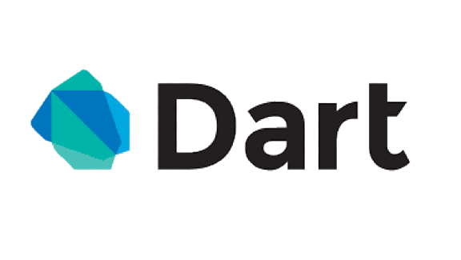

Slide 30
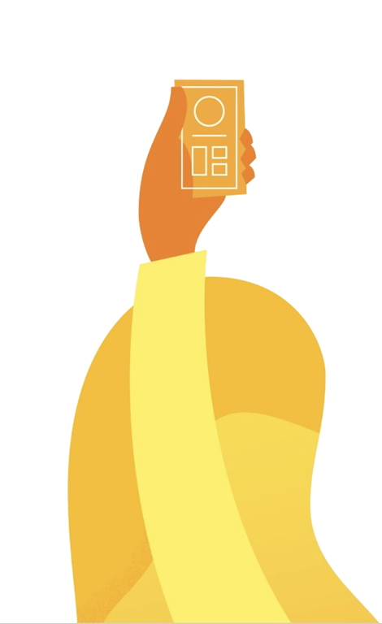
‘Why Dart?’

Slide 31
Need next slide!

Slide 32
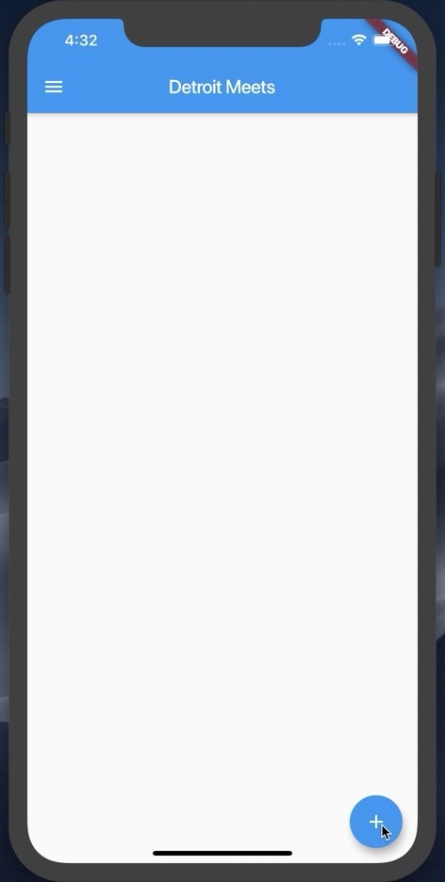
What are we building today?

Slide 33
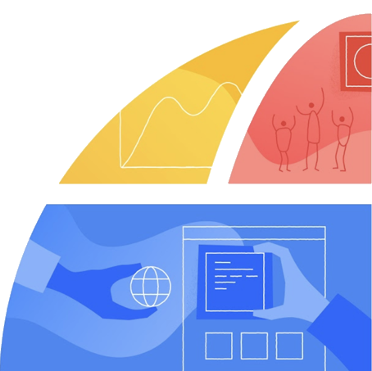
Let’s setup your environment!

Slide 35
Let’s start
Flutter SDK installed
Visual Studio Code installed
Android emulator or iOS simulator running
http://bit.ly/detroitmeetsflutter

Slide 36
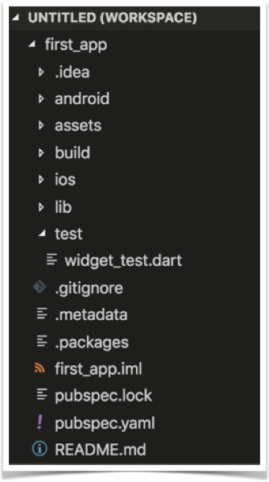
Project Structure

Slide 37
Let’s start from scratch
In VS Code, open the main.dart file
Wipe it clean
Add the code below
//Example 1
import 'package:flutter/material.dart';
void main() {}

Slide 38
Let’s attach something to the screen
The runApp method
In Dart, ‘=>’ is equivalent to {return expr};
//Example 2
import 'package:flutter/material.dart';
void main() => runApp(<Widget>);

Slide 39
‘Let’s talk about Widgets’

Slide 40
Widgets
Everything is a widget
Stateless Widgets
Stateful Widgets
class StatelessWidgetExample extends StatelessWidget{};
class StateFullWidgetExample extends StatefulWidget{};

Slide 41
Let’s create our first Widget
//Example 3
import 'package:flutter/material.dart';
void main() => runApp(MyApp());
class MyApp extends StatelessWidget{
@override
Widget build(BuildContext context) {
// TODO: implement build
return null;
}
}

Slide 42
Let’s add some Material Design
//Example 4
@override
Widget build(BuildContext context) {
return MaterialApp(
title: ‘CUCSC Conference’,
);
}
}

Slide 43
‘Exciting Stuff! Let’s talk about Constructors!’

Slide 44
Widgets & Constructors
Positional and Named Parameters
Named Parameters declared with {}

Slide 45
The Text Widget
Text(String data, { Key key, TextStyle style, StrutStyle strutStyle, TextAlign textAlign, TextDirection textDirection, Locale locale, bool softWrap, TextOverflow overflow, double textScaleFactor, int maxLines, String semanticsLabel })

Slide 46
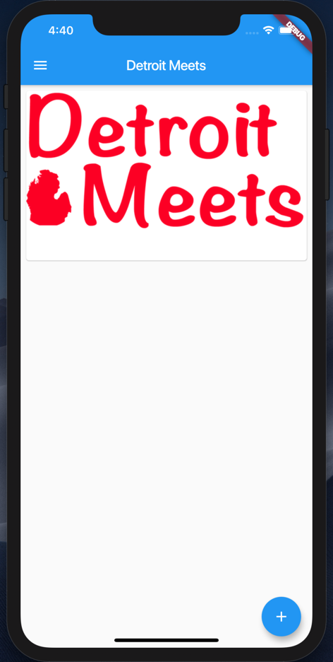
Let’s add some Widgets
Add a Card per Image
Add a Floating Action Button

Slide 47
Add a Scaffold for the Screen
//Example 5
return MaterialApp(
title: Detroit Meets',
home: Scaffold(
appBar: AppBar(
title: Text(‘Detroit Meets'),
),
));

Slide 48
Add a Card to the Body
//Example 6
home: Scaffold(
appBar: AppBar(title:Text(‘Detroit Meets’),),
body: Card(child: ,));
}
}

Slide 49
Add a Column to the Card
//Example 7
... appBar: AppBar(
title: Text(‘Detroit Meets’),
body: Card(child: Column(children: <Widget>[],),
),
));
}...

Slide 50



Let’s add some images
Steps:
Create a new assets folder and add images
Modify pubspec.yaml file

Slide 51
Add a Image to the Card
//Example 8
...
child: Column(
children: <Widget>[
Image.asset(‘assets/detroit_meets.jpeg'),
],
),...

Slide 52
Guess what – Padding is a Widget
//Example 9
Below the Image...
Padding(padding: const EdgeInsets.all(8),
),
],
),
)));...

Slide 53
Margin is inside a Widget
//Example 10
...
body: Card(
margin:EdgeInsets.all(8),
child: Column(
children: <Widget>[
Image.asset(‘assets/detroit...'),
...

Slide 54
ListViews give us scroll
//Example 11
...
body: ListView(
children: <Widget>[
Card(
margin: EdgeInsets.all(8),
child: Column(
...

Slide 55
Let’s add a Floating Action Button
//Example 12
...
body: ListView(children: <Widget>[
...
floatingActionButton: ,));

Slide 56
Let’s add a FAB object
//Example 13
...
floatingActionButton: FloatingActionButton(
child: const Icon(Icons.add),),
));

Slide 57
onPressed() for the FAB
//Example 14
floatingActionButton: FloatingActionButton(
child: const Icon(Icons.add),
onPressed: () {}),
));

Slide 58
Everything is in place now. Let’s wire up the button and images to the list.
WARNING: BOILERPLATE CODE AHEAD

Slide 59
Let’s add a list of Images
//Example 15
class MyApp extends StatelessWidget {
// Declare a set list of images to cycle through
final List<Image> _itemImages = [
Image.asset('assets/detroit_cityscape.jpg'),
Image.asset('assets/detroit_meets.jpeg'),
Image.asset('assets/tigers-d.jpg')
];
int _index = 0;
List<Image> _listOfImagesForScreen = [];

Slide 60
Boiler Plate Alert – A Stateful Class
//Example 16
class MyApp extends StatefulWidget {
@override
State<StatefulWidget> createState() {
return _MyAppState();
}
}
class _MyAppState extends State<MyApp> {

Slide 61
Let’s make the button do something
//Example 17
//Add to the main class above the build method
void onButtonPressed() {
setState(() {
_index++;
if (_index >= _itemImages.length) {
_index = 0;
}
_listOfImagesForScreen.add(_itemImages[_index]);
})}

Slide 62
Update the ListView
//Example 18
home: Scaffold(
appBar: AppBar(
title: Text('Detroit Meets'),
),
body: ListView(
children: _listOfImagesForScreen
.map((element) => Card(
margin: EdgeInsets.all(8),

Slide 63
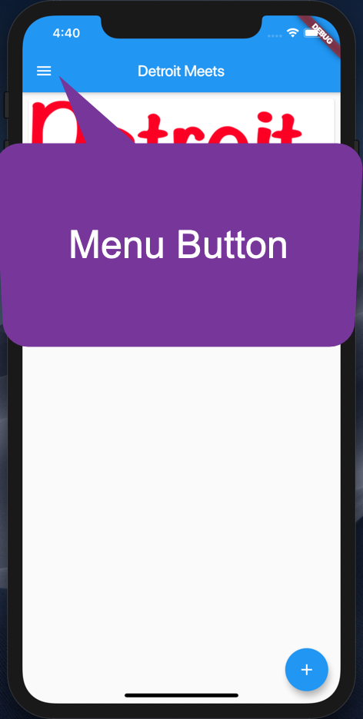
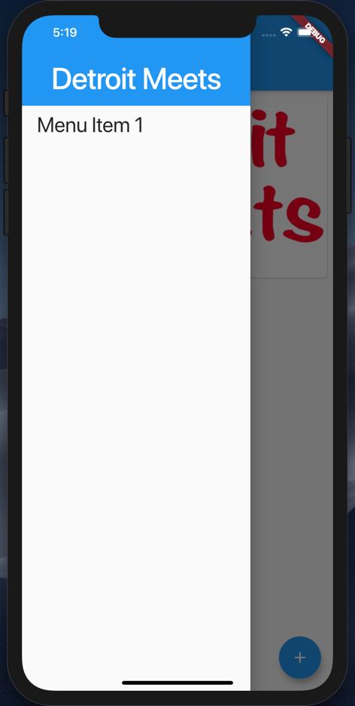
Let’s add a Nav Drawer

Slide 64
A simple Nav Drawer
//Example 19
drawer: Drawer(
child: ListView(
padding: EdgeInsets.zero,
children: <Widget>[
Container(
height: 128.0,
child: DrawerHeader(
child: Text(
'Detroit Meets',
...

Slide 65
What did we learn?
Command Line Tool for Flutter
Project Structure
Widgets
Constructors and Named Parameters
Stateless and Stateful Widgets
A few Widgets ☺
http://bit.ly/detroitmeetsflutter

Slide 66

Thank you!
Don Ward
Quicken Loans
Senior Research Engineer
donward@quickenloans.com
@donwardpeng

